Slide 1
Math Solvers

Slide 2

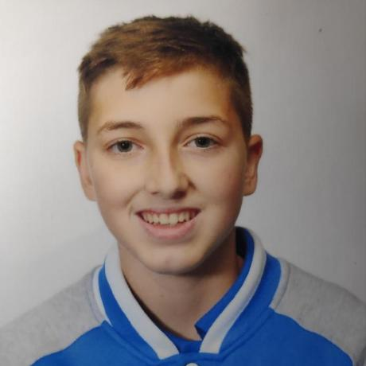
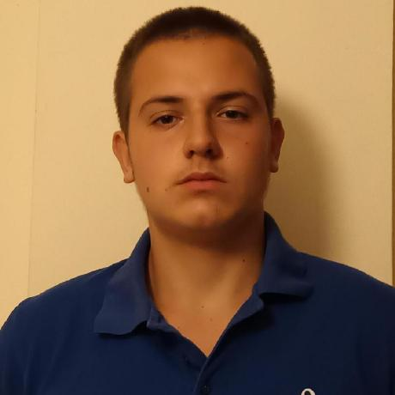
OUR TEAM
Ivan Tsvyatkov
QA Developer
Dimitar Byandov
Frontend Developer & Backend Developer
Stiliyan Mishev
Scrum Trainer

Slide 3

Idea

Slide 4

Stages
1. Discussing the idea
2. Coding
3. Debugging
4. Present the project

Slide 5








Used programs

Slide 6

Let's jump to the game

Slide 7


